Slide 1
Data Transport
PASS
Lab Assignment

Slide 2
Instructions
Make a copy of this document and fill it with your responses.
For each question, use the space on the slide to show your response, and/or add additional slides as needed. Highlight your responses in orange where possible so that we can see them easily
Place the completed document into your Lab Assignments folder and include a link to the document when you submit. Place your code into an appropriately named directory within your git repository.
Submit using the lab assignment submission form which can be found on the class website.

Slide 3
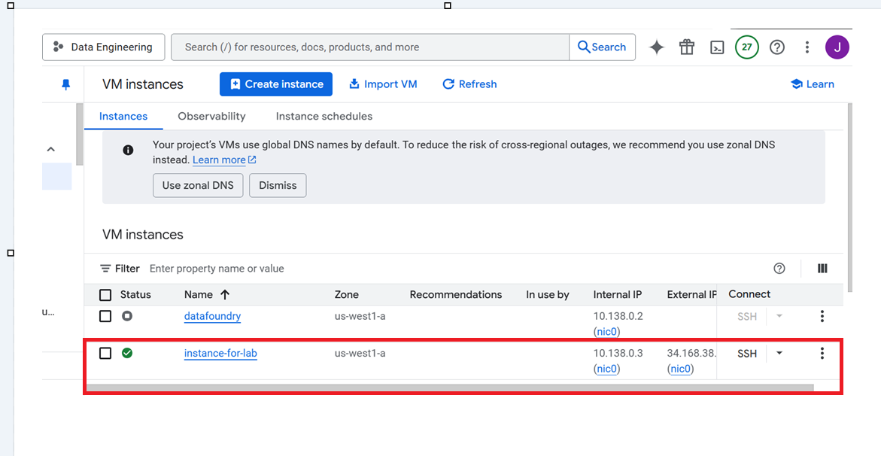
1. Get your cloud.google.com account up and running
Redeem your GCP coupon
Login to your GCP console
Create a new, separate VM instance
Respond with a “Done!” below when finished and highlight your response in orange
DONE

Slide 4
2. Pub/Sub Tutorial
Complete this PubSub tutorial: link Note that the tutorial instructs you to destroy your PubSub topic, but you should not destroy your topic just yet. Destroy the topic after you finish all parts of this lab assignment.
When finished, respond with an orange “Done!”
DONE

Slide 5
3. Create Sample Data
Get data from https://busdata.cs.pdx.edu/api/getBreadCrumbs for two Vehicle IDs from among those that have been assigned to you for the class project.
Save this data in a sample file (named bcsample.json)
Update the publisher python program that you created in the PubSub tutorial to read and parse your bcsample.json file and send its contents, one record at a time, to the my-topic PubSub topic that you created for the tutorial.
Use your receiver python program (from the tutorial) to consume your records.
How many records are sent through the my-topic topic for one run of producer and consumer? Respond here with the number of records and highlight your response in orange
good
Publisher: All records have been published to projects/utopian-pact-456118-b3/topics/my-topic and message count is: 10163
Subscriber: Total number of messages received: 10163

Slide 6
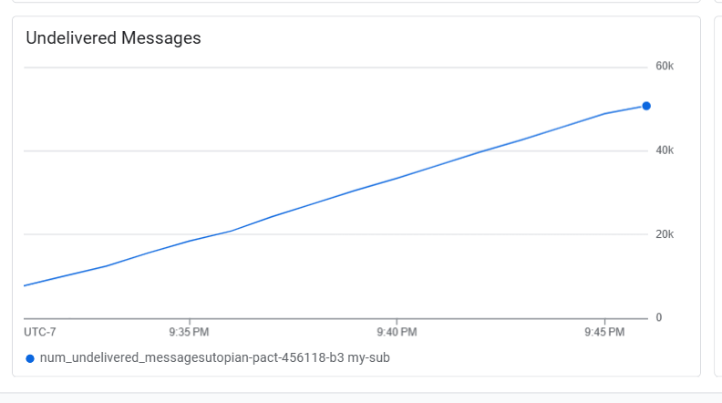
4. PubSub Monitoring
Review the PubSub Monitoring tutorial: link and work through the steps listed there.
Run your publisher five times without running your subscriber. This should create a backlog of messages.
Provide a screenshot of the PubSub monitoring dashboard showing the num_undelivered_messages metric which measures the size of the backlog.
Run your consumer once to consume all messages and clear the backlog
Where do you suppose the undelivered messages are stored?
good
Undelivered messages are temporarily stored in Google Cloud Pub/Sub's managed message storage. They remain there until a subscriber receives and acknowledges them.

Slide 7
5. Performance
The PubSub tutorial instructs you to create a consumer program that calls print() for each record. This is good for debugging, but it can lead to performance issues. Next, you will measure the performance effect of the print() calls.
Create a new data file that contains one day of data for all of the Vehicle IDs assigned to you.
Run your producer to send all of this data to your PubSub topic. How long does it take for the producer to send all of the data?
Run your consumer to consume all of the data. How long does it take for the consumer to consume all of the data?
Remove the line print(f"Received {message}.") from your consumer and add code to the consumer to count the number of messages received and to print this count once at the very end. How many breadcrumbs are produced and consumed?
Rerun part B. How long does it take to run?
Rerun part C using the new consumer. How long does it take to run?
Did changing the consumer affect the time to run? How much?
good
Initially subscriber finished publishing 684427 messages in 69.28 seconds
And Consumer Total messages received: 684427 in 315.02 seconds
After removing print statement for each record Total messages received: 684427 in 295.03 seconds.So Change of Consumer code effects the performance.

Slide 8
good
6. Multiple Publishers (Grad Students only)
Clear all data from the topic (run your topic_clean.py program whenever you need to clear your topic)
Run two versions of your publisher concurrently, have each of them send all of your sample records. For example, run each of them in separate windows, each window logged into your GCP virtual machine. Or use ‘&’ to run multiple producers in the background in a single logged-in window.
What happens when you run multiple producers concurrently? Do they seem to wait for each other? Do they take twice as long to complete?
Next, run your consumer once. Describe the results.
When I ran two producer instances concurrently, both published 684,427 messages independently in 87.05s and 94.57s. They didn’t block each other, and the total time wasn’t doubled. This shows Pub/Sub handles concurrent publishers efficiently and scales well without significant delays..After running two concurrent producers, the consumer received 1,368,854 messages in 520.06 seconds, confirming successful and efficient message delivery.

Slide 9
7. Provide your code
Save your code within a folder called “DataTransport” (or a similar name) within your git repository.
Provide a URL link to your git repository:
https://github.com/jbtuku/Data-Engineering/tree/main/Data%20Transport

